Slide 1
NE 763: Advanced Reactor Materials
Fall 2025
Dr. Benjamin Beeler

Slide 2
Housekeeping
Class eval is up, please fill this out: http://go.ncsu.edu/cesurvey
helps in providing departmental feedback
I’ve also generated a course survey for my own purposes:
survey LINK
will be anonymous, but forward me the confirmation that you filled out the form, and you will get +5 on the last exam (on top of the curve)
Last exam on Dec. 2
Might wrap up today, or potentially next Tuesday
Will complete lecture on Tuesday with ‘other stuff’ which will not be on the last exam

Slide 3
Last Time
U-Si fuels
higher U density than UAlx; U3Si2 and U3Si
Atomization of particles to limit surface area and residual stresses
U-Si swells more than UAlx from fission gas swelling
U3Si exhibits larger bubbles than U3Si2, and thus higher swelling
more free volume upon amorphization in U3Si, leads to lower viscosity and thus higher diffusivity
U(SiAl)3 interlayer grows slowly, doesn’t excessively swell or degrade fuel performance
Switch to U-Mo for higher U density and higher temperatures
dispersion and monolithic fuel designs
Solidus/liquidus gap leads to formation of Mo-rich islands
Gamma phase is metastable, irradiation aids in retaining gamma phase
Fission gas superlattice forms, then is destroyed from grain refinement

Slide 4
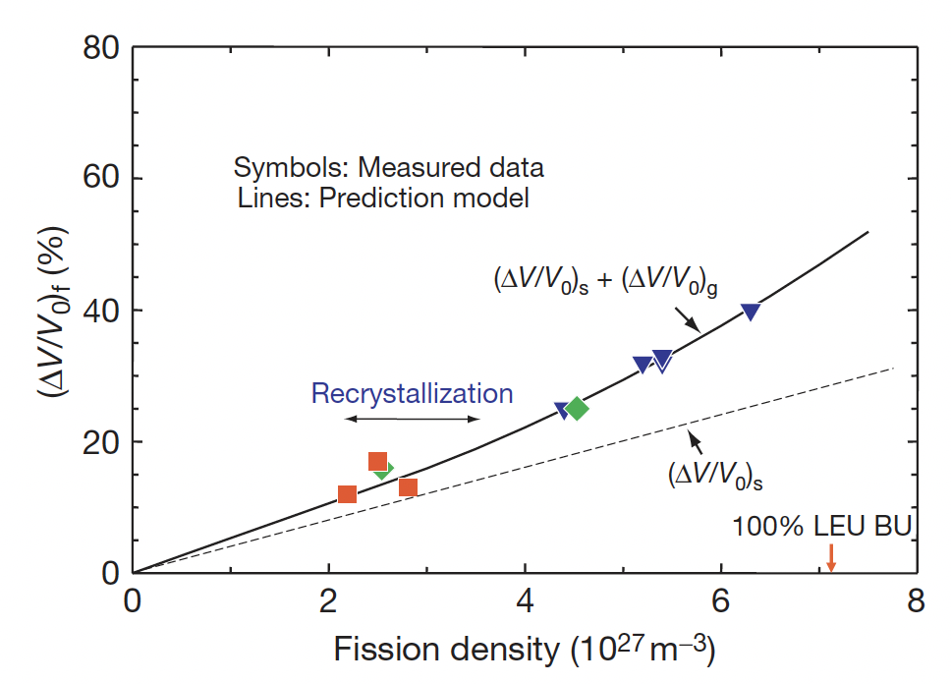
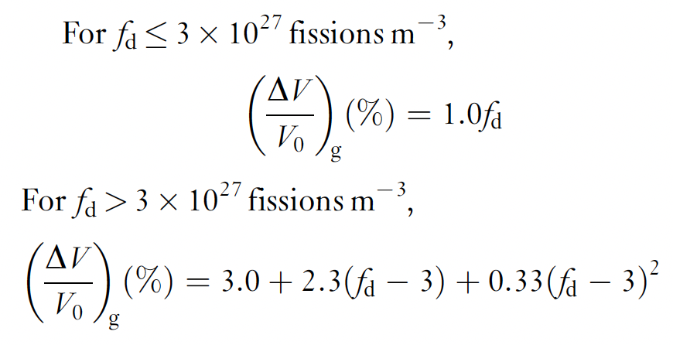
U-Mo Gaseous Swelling
Total swelling of U–Mo fuel is obtained from plate thickness changes before and after irradiation
The gas bubble swelling is obtained by subtracting the solid fission product swelling
The data can be fit to a linear function at low fission density, and a quadratic function at higher fission density

Slide 5
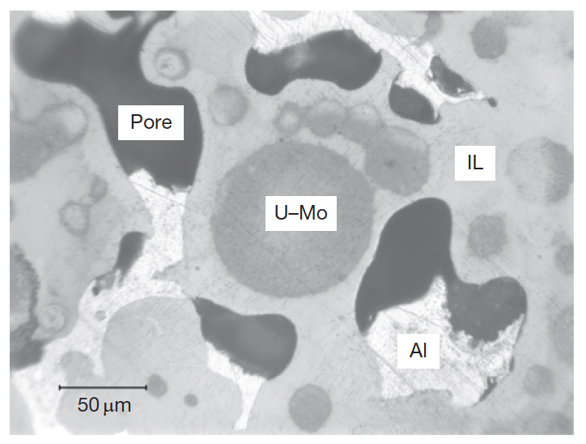
UMo-Al Interaction
The interaction layer (IL) formation between U–Mo fuel particles and matrix Al poses potential fuel failure risks
Pores tend to form in thick ILs
Variable composition of the IL is possible because of its amorphous nature during irradiation
Amorphization is usually accompanied by an increase in volume that facilitates atomic mobility, enhancing diffusion

Slide 6
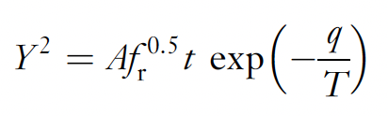
UMo-Al Interaction
The IL growth correlation follows a parabolic law, dependent upon the fission rate, temperature, and time
The Al/(U+Mo) ratio of the interaction product in the (U–Mo)–Al dispersion from out-of-pile tests is in the range 3.5–7.6
Based upon our knowledge of the U-Al system, the Al/U ratio is 2, 3 or 4
Thus, Mo is facilitating the formation of higher Al content compounds
As the Mo content increase, , the formation of (U,Mo)Al3, is suppressed, and the Al content in the IL increases
The formation of high-Al content IL is unfavorable because: 1) its lower density, leading to more swelling; and 2) high Al content linked to IL pore development

Slide 7
Alloying Additions
A method to suppress the formation of UAl4 in the U–Al system depends on finding an element to suppress the peritectoid reaction UAl3 + Al ->UAl4
There are a number of additives which have been identified to inhibit this reaction, most notably Ge, Si, Sn, and Zr
In the US, Si was primarily investigated in UMo dispersion fuels to inhibit Al4 formation and suppress IL growth
Si dramatically reduces the IL thickness
The ILs of Si-added plates are commonly uneven, with different thicknesses on different particles
This is due to the non-uniform concentration of Si
At higher burnups, the IL continues to grow and the effect of Si is weakened

Slide 8
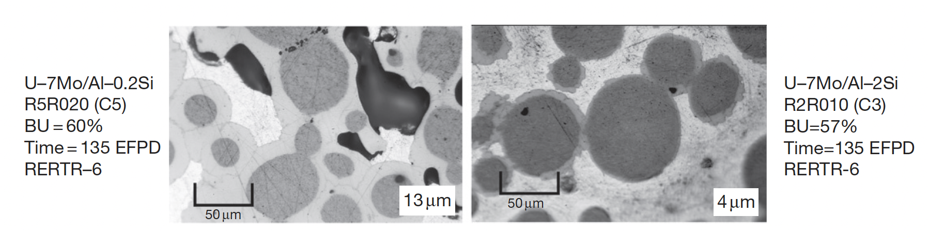
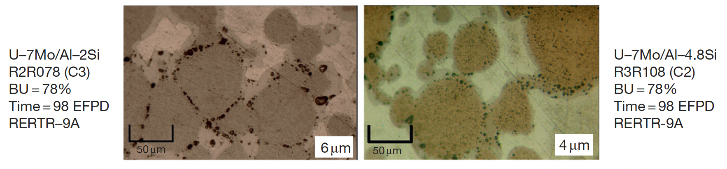
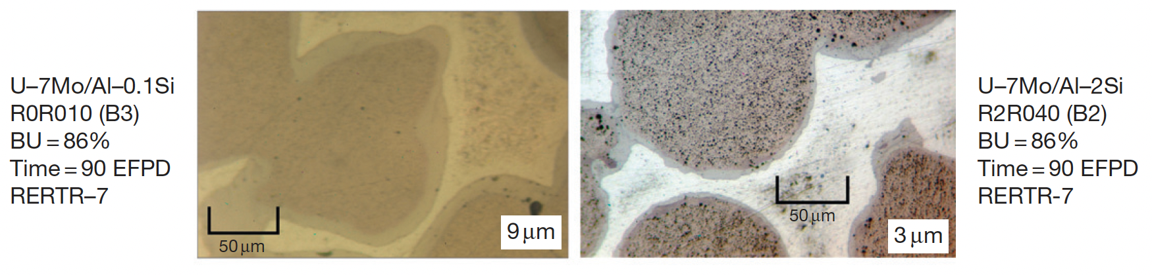
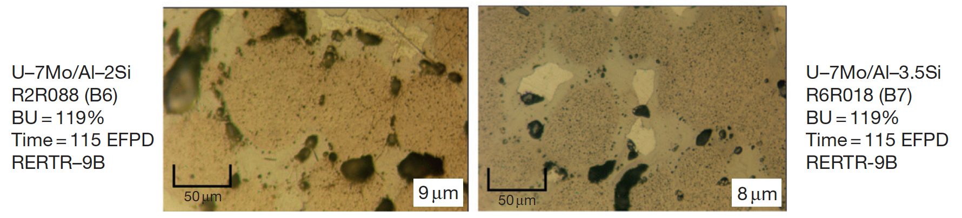
Addition of Si

Slide 9
U-Mo Dispersion to Monolithic
Higher power, high-burnup testing of aluminum matrix U-Mo dispersion fuel revealed a pattern of breakaway swelling behavior at intermediate burnup
Breakaway swelling is defined by a rapid or unpredictable transition to high swelling behavior
This swelling behavior was due to interaction of the fuel particles with the Al matrix, forming (U,Mo)Al compounds
Large fission gas bubbles can form in these phases, weakening the fuel and exerting gas pressure, potentially resulting in fuel failure
To remove this (U,Mo)Al phase, we can: 1) coat the particles; 2) modify chemistry (such as by adding Si); 3) substitute the Al matrix with another materials; 4) remove the matrix

Slide 10
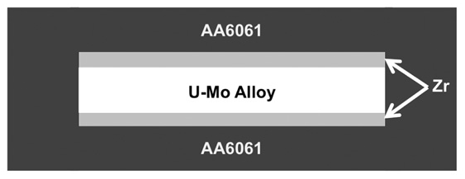
Monolithic Fuels
The U–Mo monolithic fuel, in which a U–Mo thin foil is sandwiched between a Zr liner and directly bonded to cladding, is currently under development
This fuel design has the advantage of providing higher U density than the dispersion form while essentially eliminating the problem related to reaction products between the fuel and matrix
Si additives were tried, but led to delamination of the fuel from cladding
This image is not to scale

Slide 11
Foil/Plate Fabrication
Any new nuclear fuel first requires the development of conceptual fabrication technology to prepare samples for irradiation testing
Monolithic fuel is fabricated, in general by (1) alloying and casting, (2) foil rolling, 3) bonding of the cladding, and (4) finishing and inspection for quality assurance
Fabrication processes are still being refined
Alloying is typically performed through vacuum induction melting (VIM) or arc melting of uranium and molybdenum metals at a temperature of 1300 1500C.
The molten alloy is typically cast into a coated graphite book mold
The casting is surface machined into a ‘coupon’ of the appropriate size for reduction into a foil though hot and cold rolling

Slide 12
Foil/Plate Fabrication
Foil fabrication involves reducing the thickness of a cast alloy coupon to the desired fuel foil thickness while simultaneously bonding the Zr barrier layer to the surface of the U-Mo
Hot rolling operations are conducted with the alloy temporarily encapsulated in a steel rolling can
This allows the material to be heated to 650C in air without oxidizing the fuel alloy and the Zr
After decanning, the resulting U-10Mo fuel foil, bonded to two thin (0.025 mm) layers of zirconium, sandwiched between two sheets of aluminum and placed in a steel can for HIP (Hot Isostatic Press) processing
The HIP process is typically conducted at a temperature of 560C for a time of 90 minutes or longer
The HIP can is cut open; the bonded plates are removed, and the plates are finished to final dimensions and inspected

Slide 13
U-Mo Microstructure
The microstructure of U-Mo foil depends on feedstock impurity content, the starting condition of the fuel coupon, and the rolling schedule
The size and morphology of the grains depend on the thermo-mechanical treatments that are used during fuel-plate fabrication
Molybdenum depleted and enriched regions in the as-cast microstructure resulting from solidification form elongated features during rolling
Bands of differing Mo concentration can be observed in the final foil
Decomposition of the original gamma phase results in a lamellar structure comprised of alpha-U and gamma'-phase
These lamellar structures can manifest themselves as bands within the foil microstructure, or as decomposed regions along the grain boundaries

Slide 14
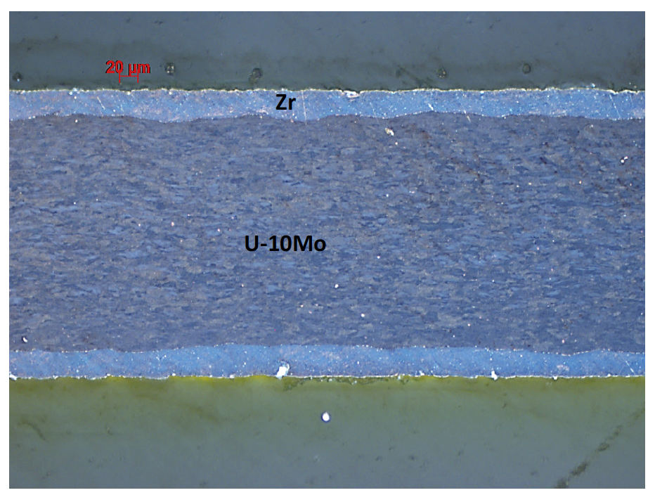
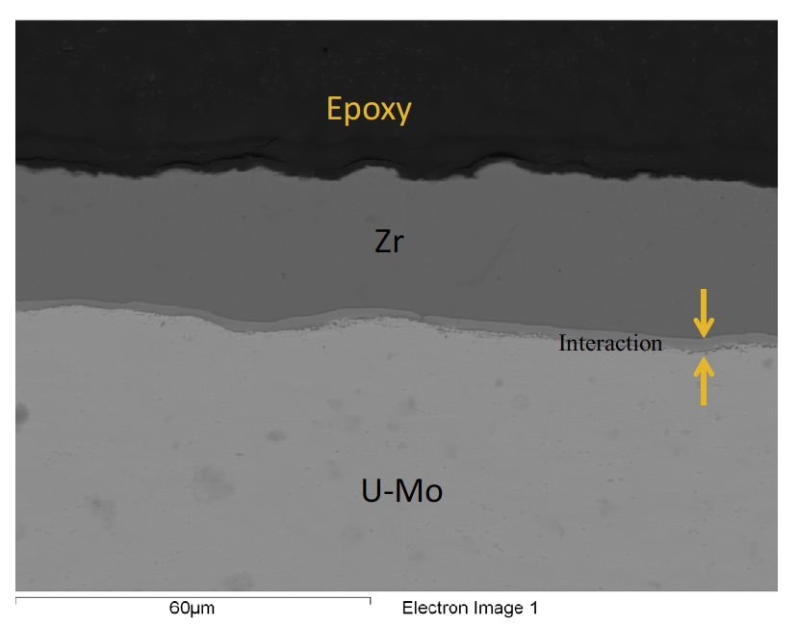
Interdiffusion Barrier
A key feature that defines the irradiation performance of monolithic fuel is the interface between the fuel meat and the cladding
The approach was to minimize the interaction between the U-Mo fuel foil and the cladding through introduction of a Zr diffusion barrier
A barrier thickness of 25 μm was selected to exceed the maximum fission fragment recoil range (~9 μm) and to allow for variability in the manufacturing process

Slide 15
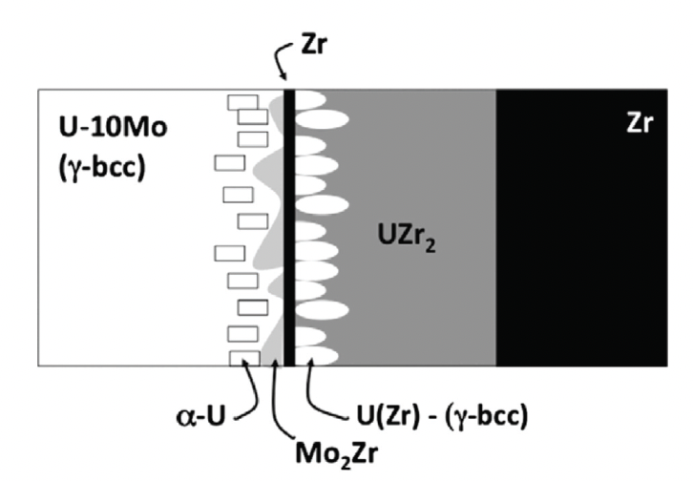
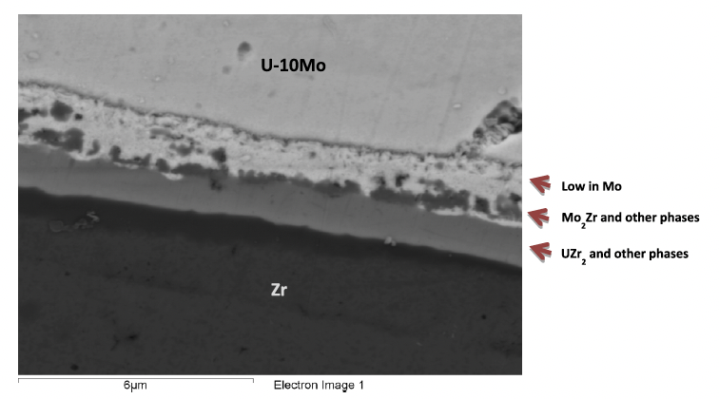
Interaction Layer
The U-Mo/Zr interface contains multiple phases that develop during the interdiffusion that occurs between U-10Mo and Zr during the co-rolling and HIP processes
Phases observed near the U-10Mo interface with the Zr diffusion barrier include: UZr2, gamma-UZr, Zr solid solution, Mo2Zr phases, and small amounts of alpha-U were also observed in the Mo depleted zone that forms

Slide 16
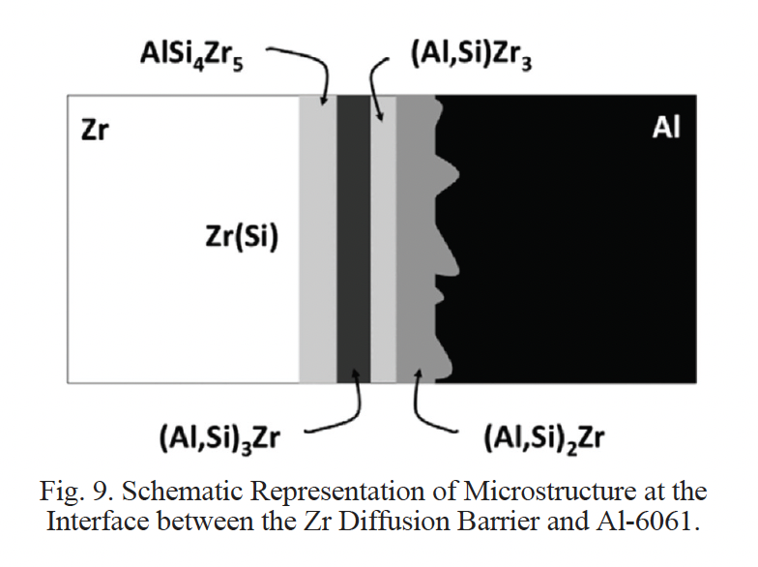
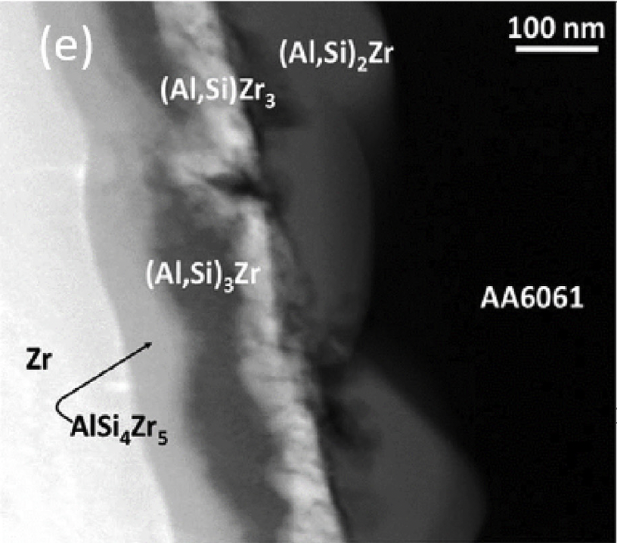
Zr/Al Interaction Layer
The Zr/Al-6061 cladding interface must also be well-bonded and stable
This multi-phase zone develops during HIP processing
Ten different binary Al-Zr intermetallic compounds exist, however, not all form
Si interacts with the Al-Zr system to form four distinctive layers AlSi4Zr5, (Al,Si)Zr3, (Al,Si)3Zr and (Al,Si)2Zr
Interdiffusion layer can be limited by processing at lower temperatures

Slide 17
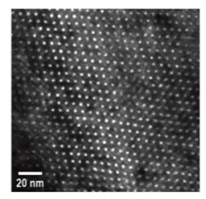
Monolithic Irradiation Behavior
The key phenomena that affect the dimensional stability of a monolithic fuel plate during irradiation are fuel swelling, phase transformation under irradiation, radiation-enhanced diffusion resulting in the formation of unstable phases, creep of materials, and mechanical-property degradation
These are similar to dispersion fuels, with the difference of a single connected fuel system and the potential for macroscale changes
Fuel swelling undergoes the fission gas superlattice formation, and subsequent recrystallization (and FGS destruction) leading to accelerated swelling
Solid fission product swelling occurs in the same manner as with other intermetallic fuels

Slide 18
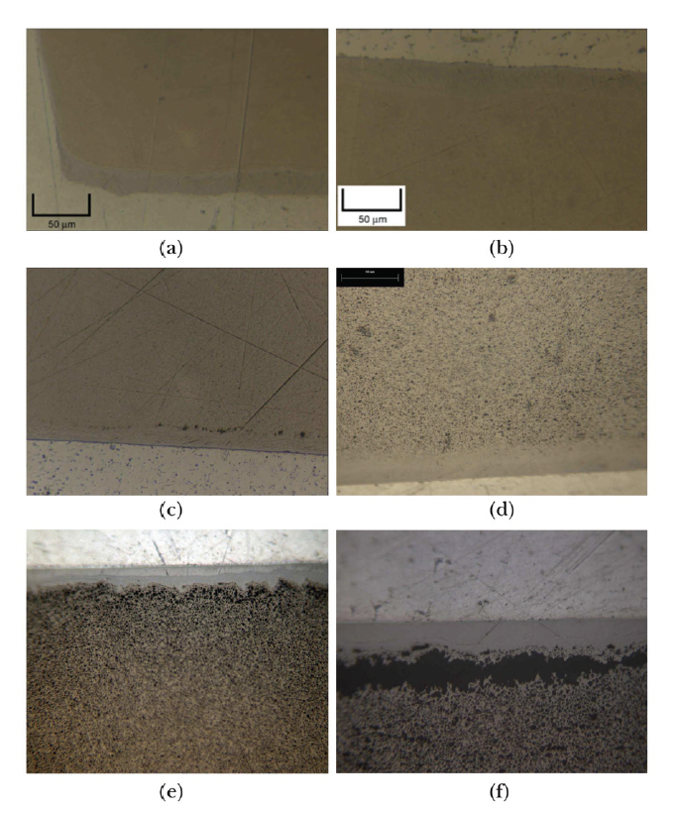
Microstructure Evolution
At fission densities in the range of 2.2E27 to 4.0E27 f/m3, little microstructural change is apparent using OM
As fission density increases from 4.0E27 f/m3 to 6.2E27 f/m3, grain refinement occurs, and formation of micron-scale porosity is visible in some regions near the U-Mo/Zr interface
At a fission density of 7.2E27 f/m3, grain refinement has occurred throughout the majority of the microstructure
Delamination of the fuel near the U-10Mo/Zr interface occurs at a local fission density of 9.5E27 f/m3
Fission Density
(a) 2.2, (b) 4.0,
(c) 6.2, (d) 7.2, (e) 8.4, (f) 9.5

Slide 19
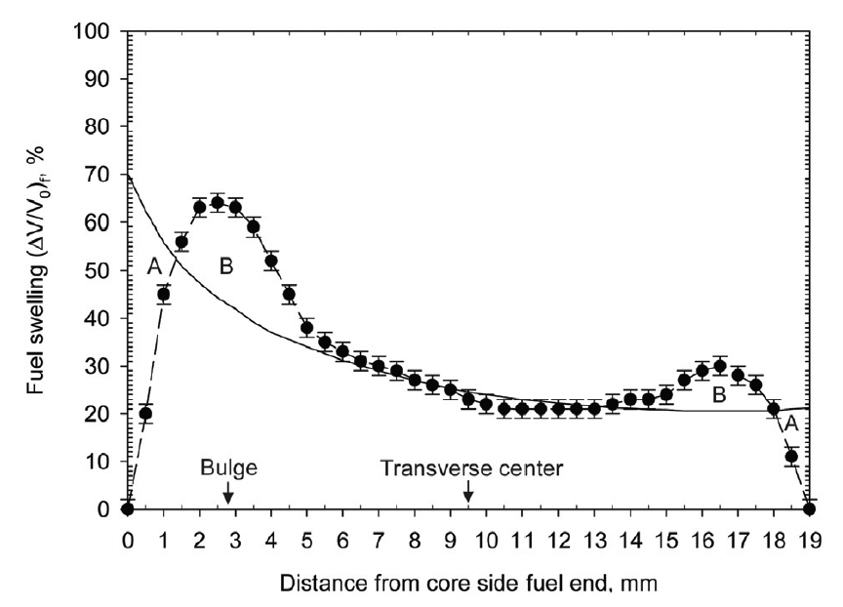
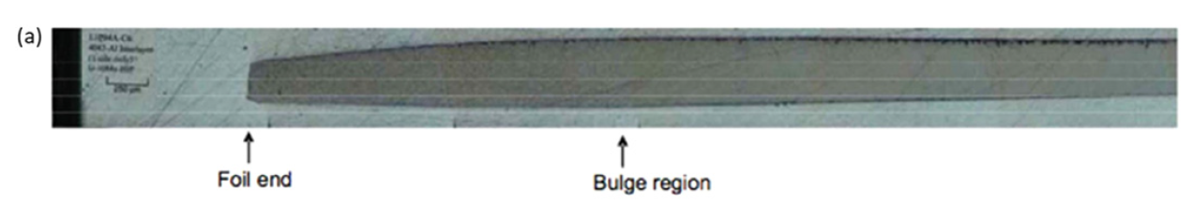
Creep and Peaking
Irradiation enhanced creep is a key phenomenon that makes the monolithic fuel system viable
Fuel foils are constrained from swelling in the plane of the fuel plate by the cladding rails, and examination of irradiated fuel plates shows that little or no dimensional change is measured in this plane
Plate failures occur in the regions of the fuel plates with the highest fission density
Peaks in fission density are caused by power peaking at the ends and edges of fuel plates in this test configuration

Slide 20
Creep Forming Bulges
The formation of this thick region can be explained by irradiation enhanced creep of the fuel driven by the stress that builds up at the rail constraint caused by fission product swelling
Swelling at the plate edges is lower than expected, due to the constraint of the plate rail
Fuel moves inward by irradiation-enhanced creep to form the thick region approximately 3 mm from the edge of the foil
While there is a creep correlation to predict this dimensional change, very little is known about U-Mo creep

Slide 21
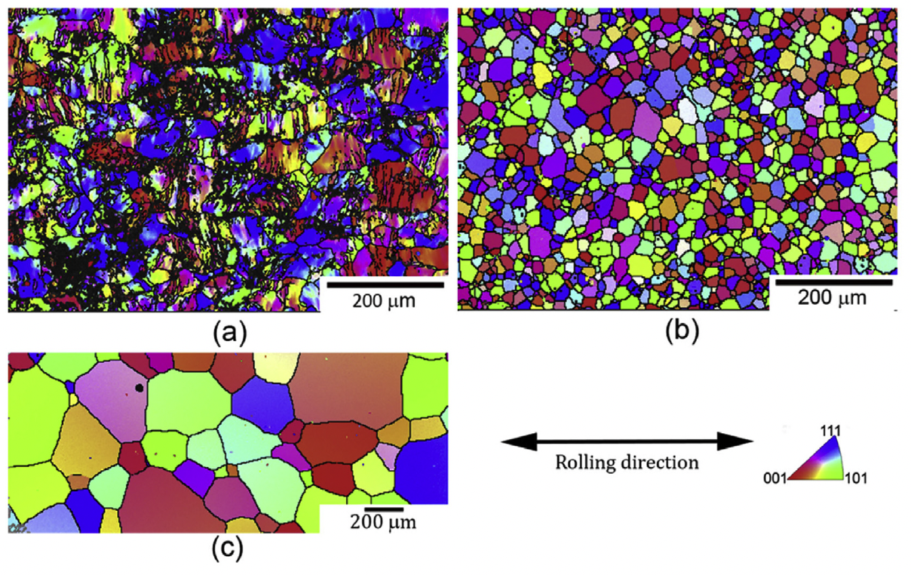
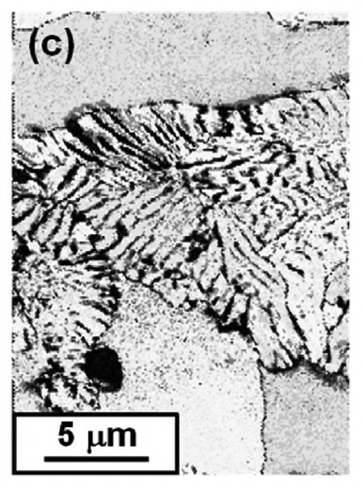
Effect of Fabrication on Microstructure
The rolling process can degrade the gamma phase, inducing phase decomposition
The eutectoid decomposition initiates when alternate lamellar structures, consisting of alpha-U and gamma-U with higher Mo content than the matrix (or potentially U2Mo), forms in U-Mo fuel
The lamellar structure tends to nucleate primarily along the prior gamma-UMo grain boundaries, but nucleation on deformation bands inside of the grains has been noted as well

Slide 22
Effect of Fabrication on Microstructure
When the as-rolled material is subjected to annealing (heat treatment), the grains relax internal stresses
Grain size distribution of U-10Mo fuel widens with an increase in annealing temperature, likely due to pinning from precipitates
Homogenization of the microstructure must be weighed against cost of high temperature fabrication processes
(a): as-rolled (b) rolled and annealed at 700C and (c) rolled and annealed at 1000C

Slide 23
Microstructure Effects on Performance
When the decomposed regions revert back to gamma-UMo, a perfect phase transformation is not possible, and a network of dislocations is left in the gamma-UMo matrix
This increased dislocation density has been experimentally associated with grain refinement zones
Thus, with an increase in the decomposed regions in the as-fabricated fuel, there are a) additional nuclei for grain refinement; or b) accumulated damage in localized regions, lowering the threshold for grain refinement

Slide 24
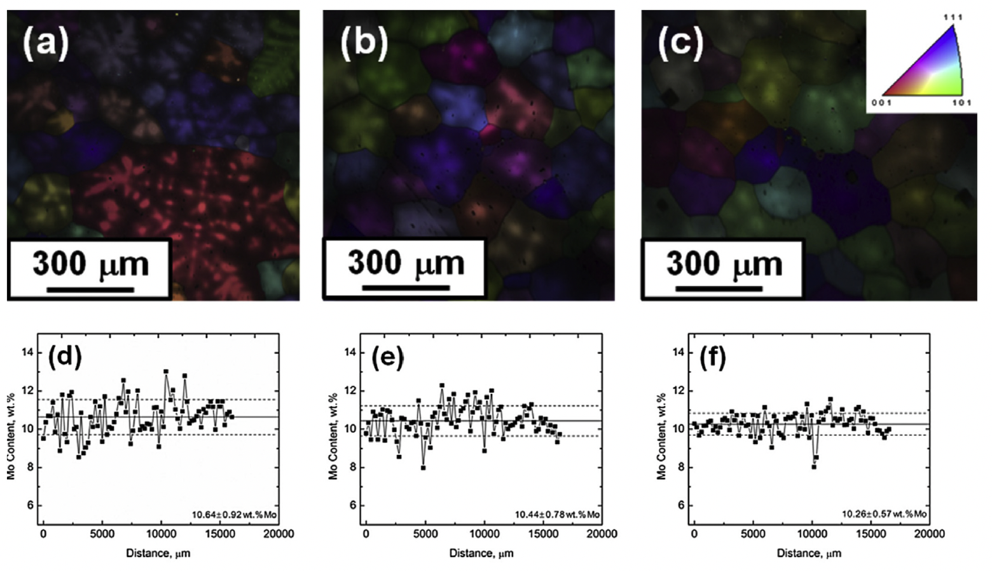
Chemical Homogeneity
Due to the solidification process, similar to atomization, Mo rich regions will solidify first, and Mo depleted grain edges/boundaries will form
Decomposition is more likely in Mo-lean areas, due to the phase diagram
Homogenization processes can be performed (high T annealing) to reduce the chemical gradients
Mo concentration gradients change with the homogenization temperature
a, b, c denote different heat treatments

Slide 25
Microstructural Modeling of UMo
Lower length scale modeling in the USHPRR program was initiated in 2015 to mitigate risks associated with unknown behaviors of UMo fuel
The AFIP6-MkII experiment exhibited early onset breakaway swelling which did not fit with previous experimental efforts
LLS modeling can explore fundamental phenomena to obtain mechanistic predictions of fuel behavior

Slide 26
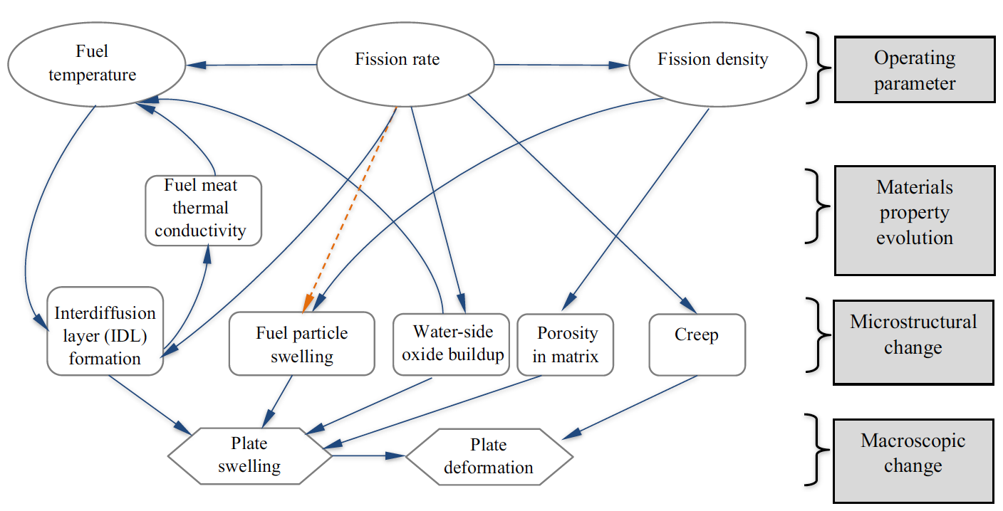
Microstructural Modeling of UMo
The major physical processes impacting RTR fuel performance are intricately related
The key four classes of physical processes: operating parameters, fuel microstructural and materials property changes, and dimensional changes of the fuel plate
Microstructural change is the result of the irradiation behavior of fuel plates

Slide 27
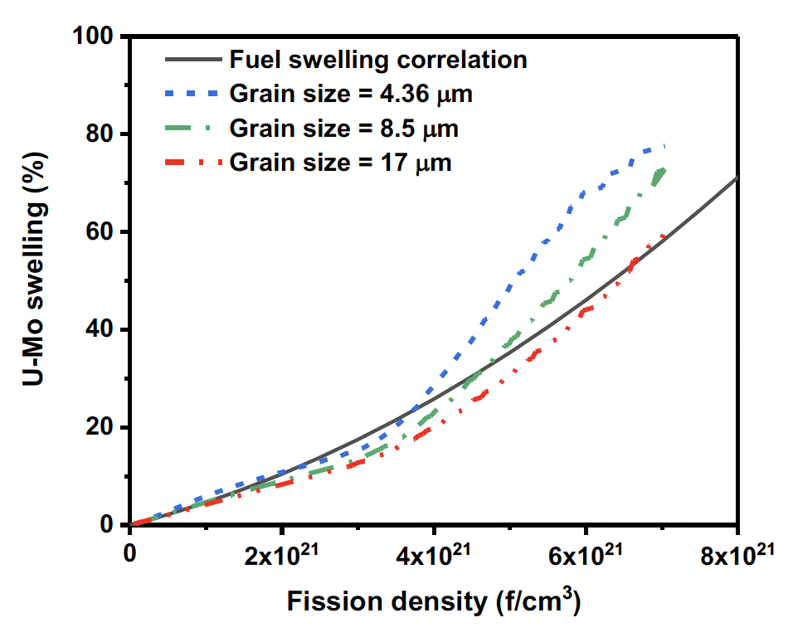
Grain Size Effects on Swelling
Grain size can affect the rate and magnitude of swelling
Initial grain size impacts the rate at which the FGS is destroyed
The initial conditions for which intergranular bubbles and new grains can nucleate are define by as fabricated grain size
The continuing rate of grain refinement is also governed by initial grain size

Slide 28
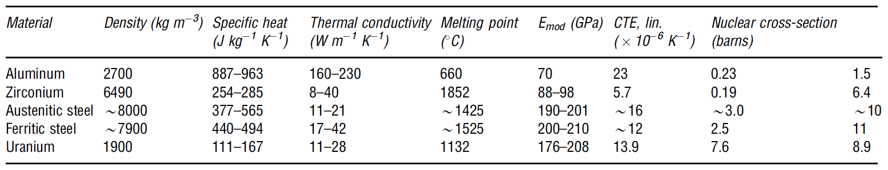
Aluminum in Research Reactors
Aluminum alloys are generally too weak or have temperature limitations that preclude their use in commercial reactors
In most research reactors where bulk water coolant temperatures are usually <100C, aluminum alloys are quite comfortable and are universally employed

Slide 29
Aluminum Benefits
Al is ductile, plentiful, cheap, and light weight
It is castable, machineable, and weldable, and it can be shaped readily by conventional processes
It has good water corrosion resistance due to near-insolubility in water and formation of a passive, self-restoring surface film of hydrated aluminum oxide
It has an fcc crystal structure and no crystallographic phase changes, with near isotropic properties
It can be strengthened by cold work, solid solution hardening, and precipitation treatments
At low temperatures, it has no ductile-to-brittle transition
It is also resistant to hydriding

Slide 30
Aluminum Drawbacks
Al has a low elastic modulus and low melting temperature
The low melting temperature of 660C imposes operating temperature limits of 100–150C
The strength condition of prehardened alloys can become compromised at temperatures above 150C and Al alloys become substantially more susceptible to creep above 150C

Slide 31
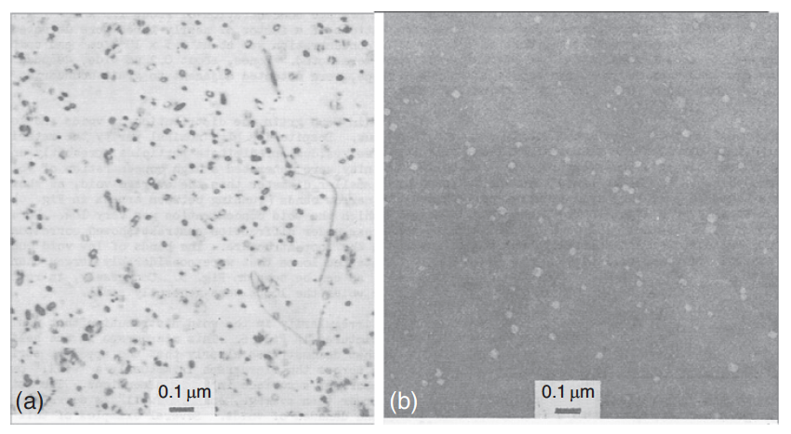
Damage Microstructure
Dislocation loops (a) and voids (b) in high-purity aluminum after irradiation at 50C to a fluence of 3.5E24 n/m2
The loops and voids are of order 30 nm diameter
In typical nuclear cladding materials, under similar temperature and neutron fluence conditions, the radiation damage microstructure is resolvable as 1–2 nm black dots

